Slide 1
OUTSOURCED ATTRIBUTE BASED ENCRYPTION WITH KEYWORD SEARCH FUNCTION FOR CLOUD STORAGE
Team Members:
U V Pavan
S Krishna Chandra
Guide:
Professor
Dr.G V Satyanarayana

Slide 2
ABSTRACT:
Cloud computing becomes increasingly popular for data owners to outsource their data to public cloud servers at the same time allowing data users to retrieve these data stored in cloud. Attribute-based encryption (ABE) technology has been used for security issues in cloud setting.
In this project Outsourced ABE (OABE) with fine-grained access control system can largely reduce the computation cost for users who want to access encrypted data stored in cloud by outsourcing the heavy computation to cloud service provider (CSP).
The proposed KSF-OABE scheme is proved secure against chosen-plaintext attack (CPA). CSP performs partial decryption task doneby data user without knowing anything about the plaintext.

Slide 3
EXISTING SYSTEM:
In this case, the File key can be uploading based on the attribute functions. The file can be uploading if the authorized person gives a key to upload a file but its integrity of the file cannot be verified.
If a group is updated, then the group key changes to be a shared key to the new group.

Slide 4
Proposed System:
The out sourced attribute based encryption with keyword search function for cloud storage, where each user is only aware of his neighbors and has no information about the existence of other users.
Further, he has no information about the network topology. Under this setting a user does not need to trust a user who is not his neighbor.
Thus, if one is initialized using public key infrastructure, then the need not trust or remember public keys of users beyond his neighbors.

Slide 5
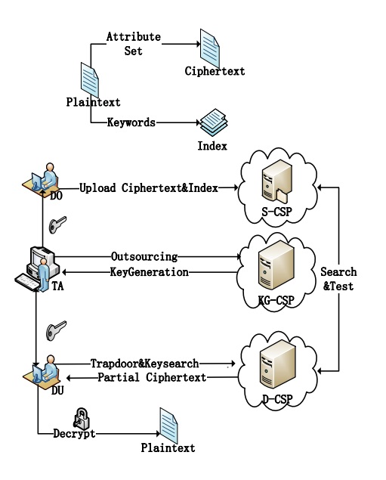
Architecture Diagram:
DO - Data Owner
TA – Trusted User
DU – Data User
S-CSP – Storage Cloud Service
Provider
KG-CSP –Key Generation Cloud
Service Provider
D-CSP – Decryption Cloud
Service provider

Slide 6
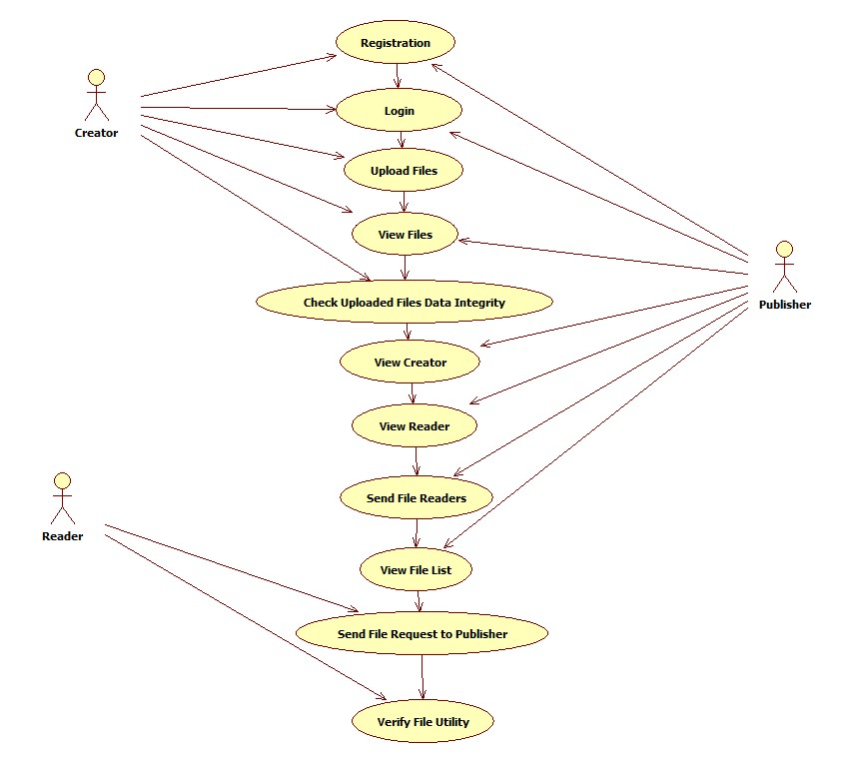
USECASE DIAGRAM
DESIGN PHASES:

Slide 7
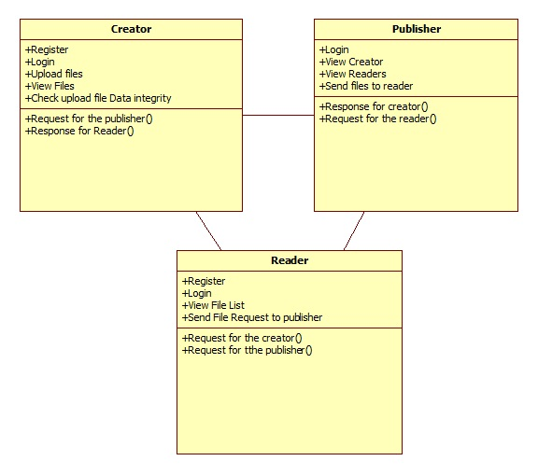
CLASS DIAGRAM

Slide 8
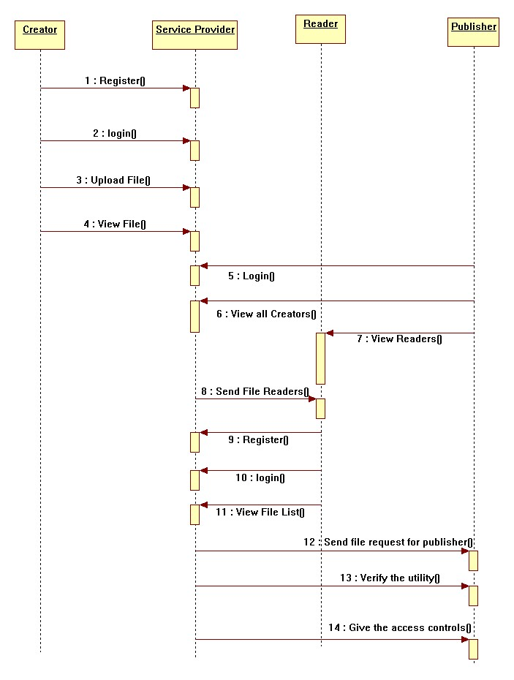
SEQUENCE DIAGRAM

Slide 9
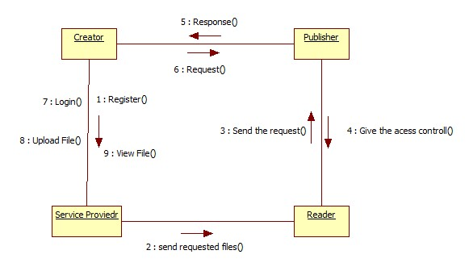
Collaboration Diagram

Slide 10
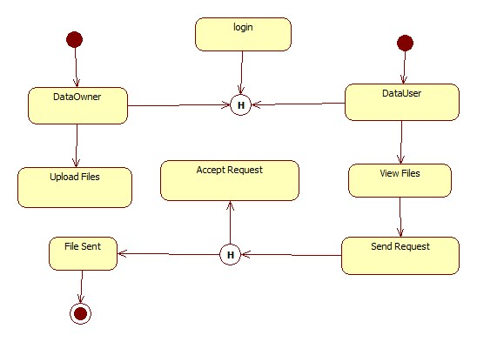
State chart Diagram

Slide 11
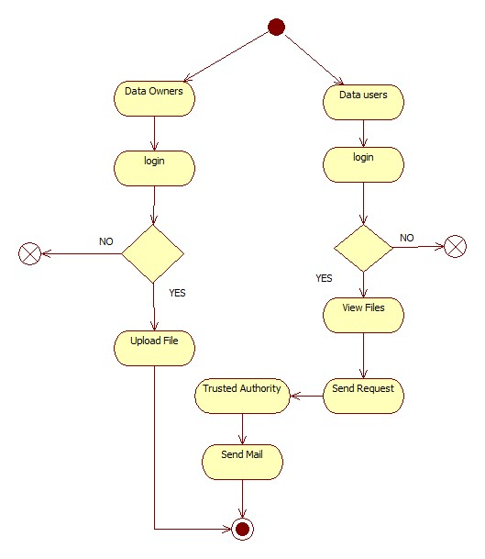
Activity Diagram

Slide 12
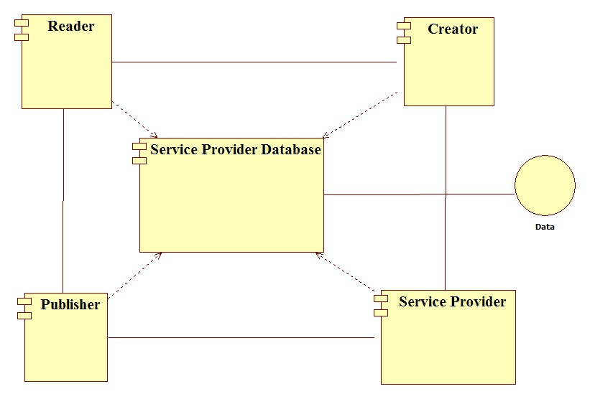
Component diagram

Slide 13
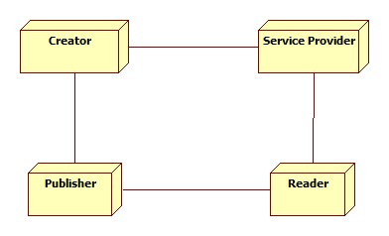
Deployment Diagram

Slide 14
SYSTEM REQUIREMENTS
H/W System Configuration
Speed - 2.69 Ghz
RAM - 1GB(min)
Hard Disk - 500 GB
Key Board - Standard keyboard
Mouse - Two or Three
button mouse
Monitor - LCD/LED

Slide 15
SYSTEM REQUIREMENTS
S/W System Configuration
Operating System : Windows XP/7
Front End : JSP
Database : My sqlserver
Database Connectivity : JDBC

Slide 16
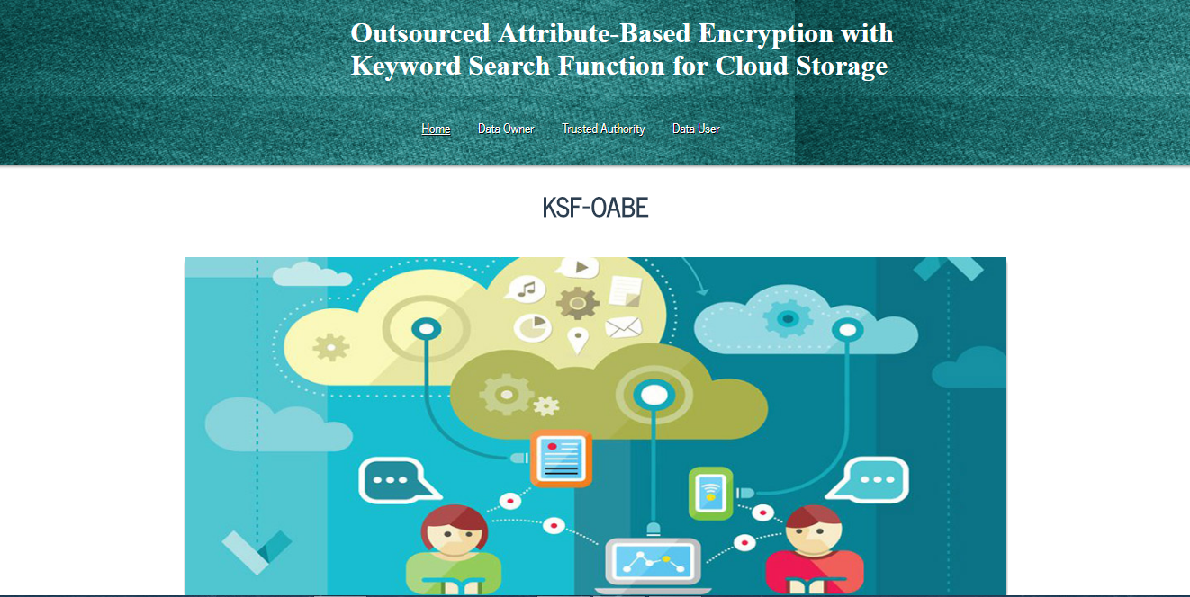
Screen shots of test cases
Home page

Slide 17
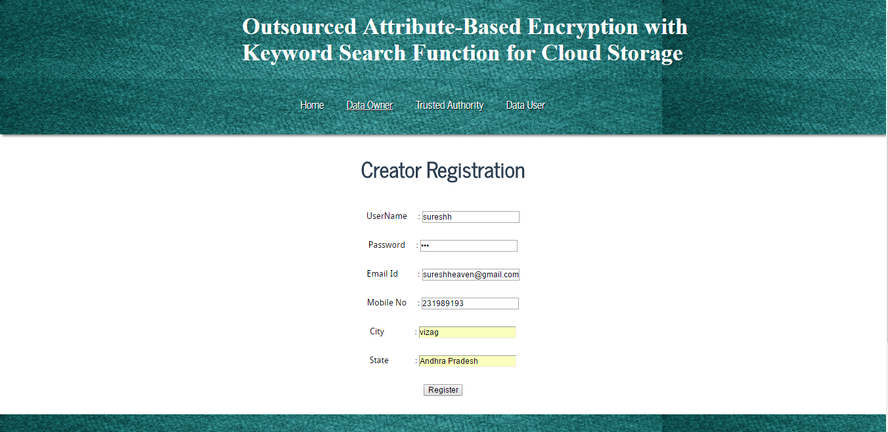
Data owner registration page

Slide 18
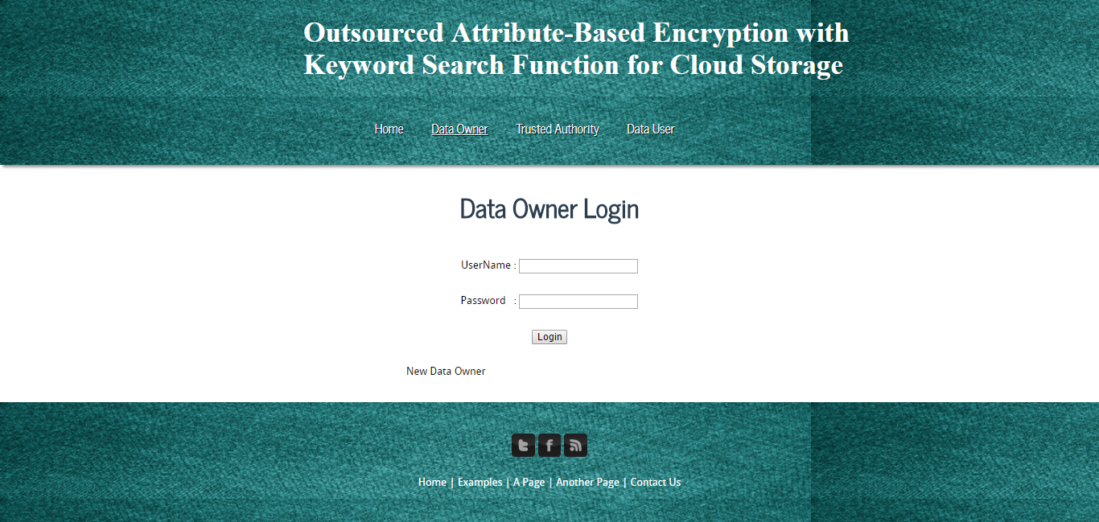
data owner login page

Slide 19
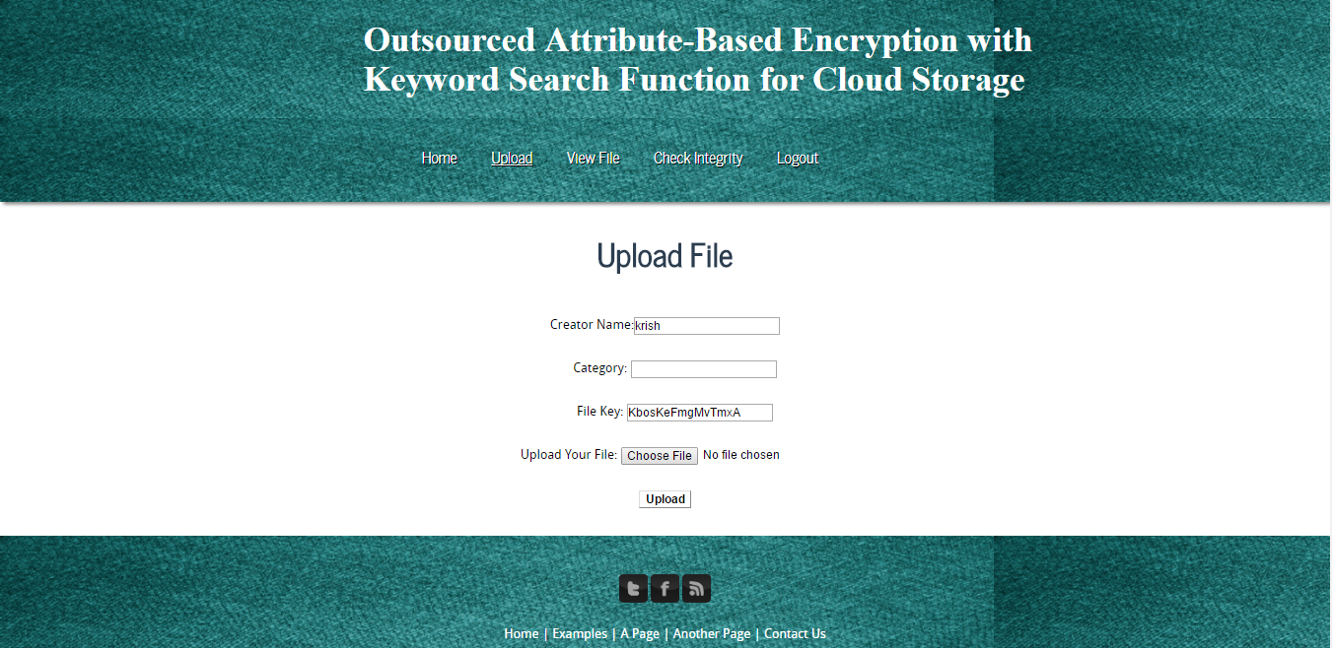
Data owner uploading file.

Slide 20
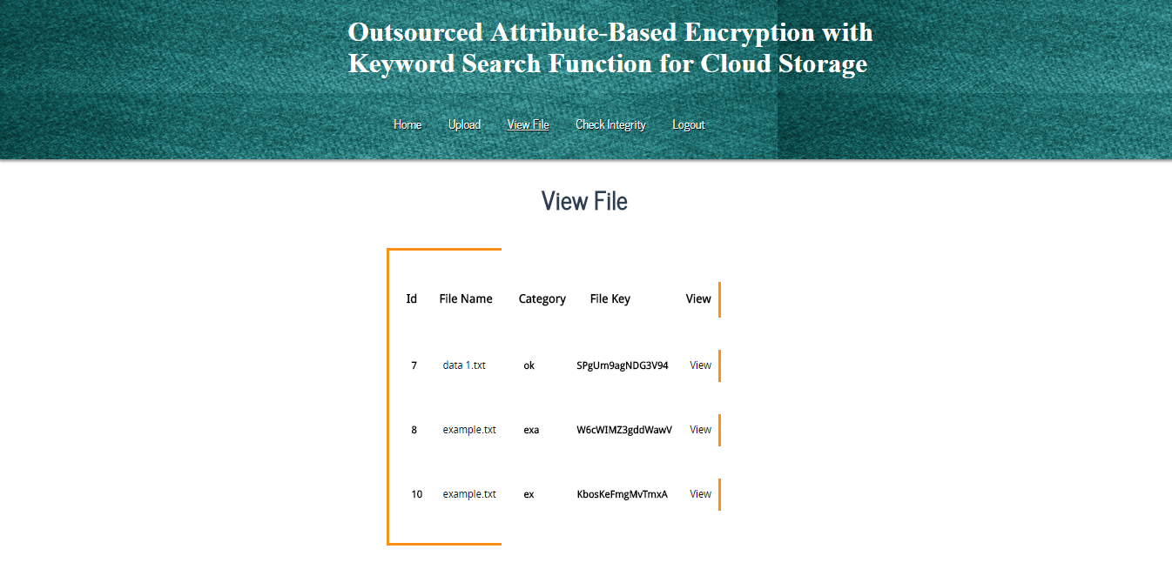
List of files uploaded

Slide 21
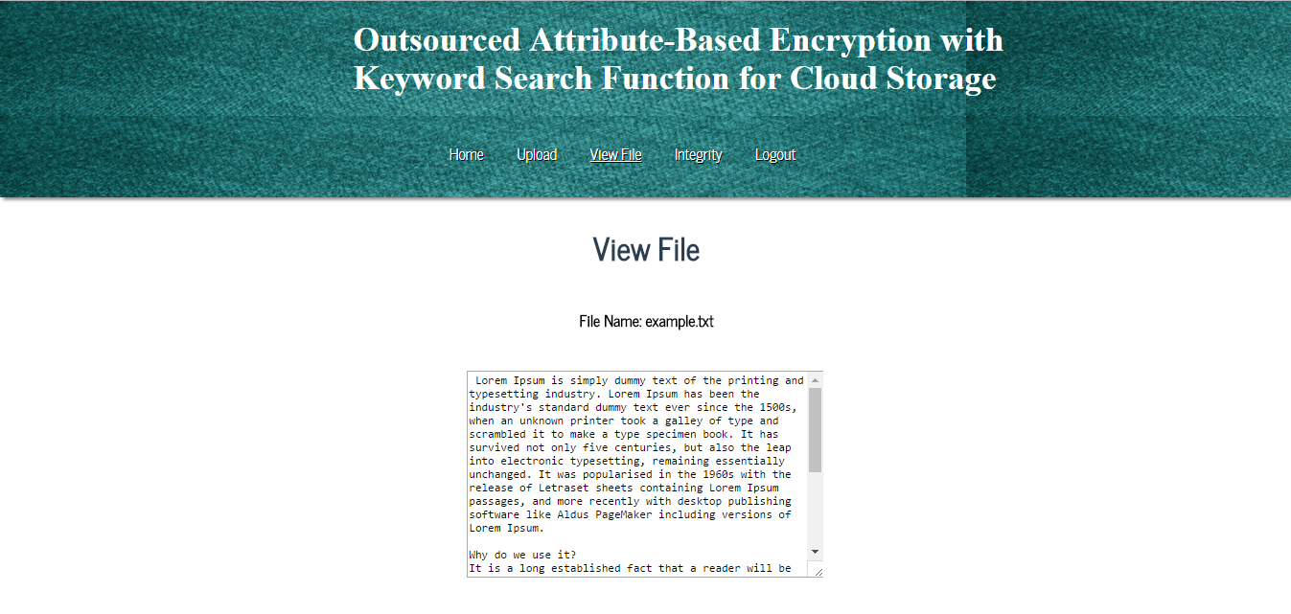
Viewing file

Slide 22
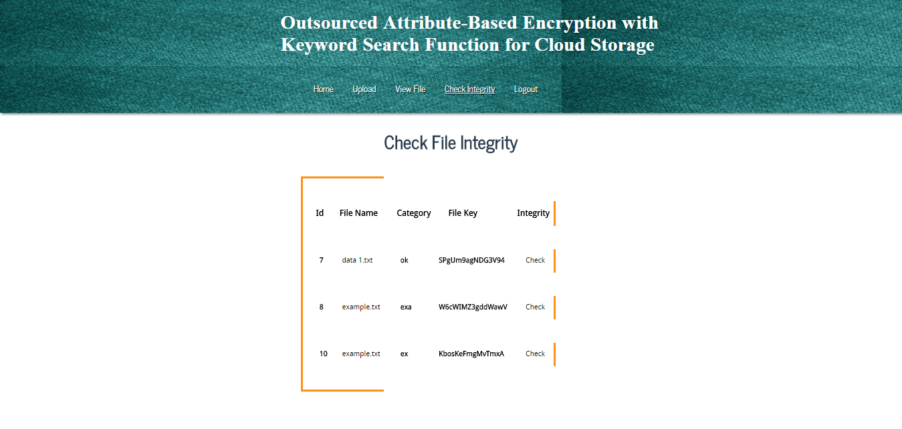
Viewing file

Slide 23
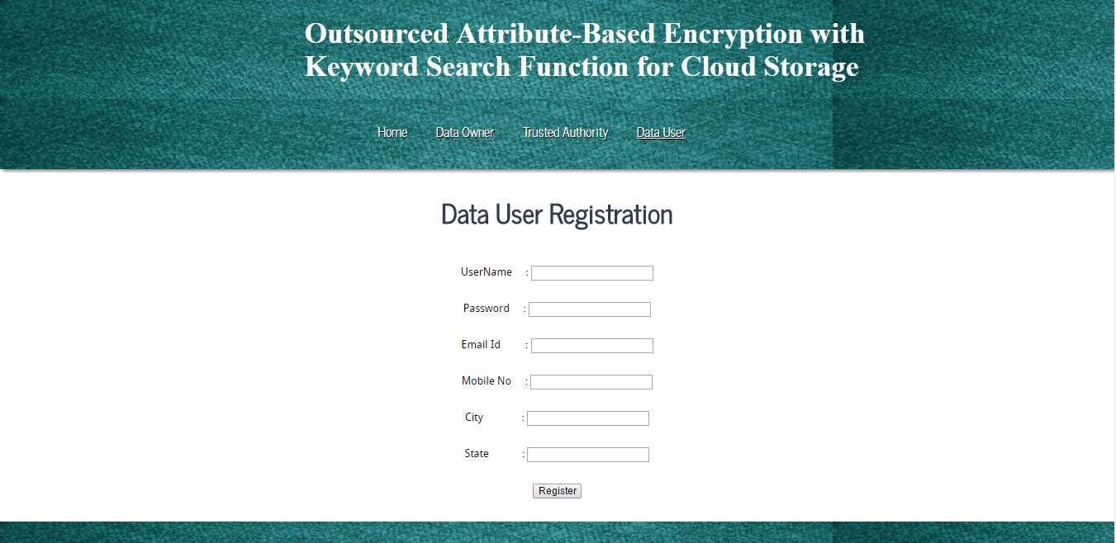
Data user registration

Slide 24
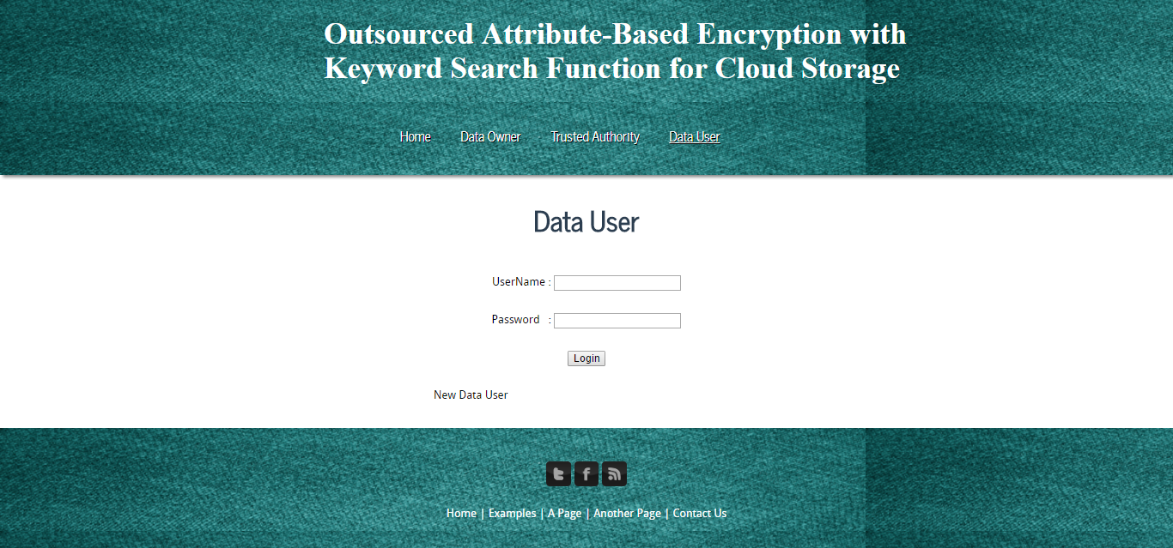
Data user login page

Slide 25
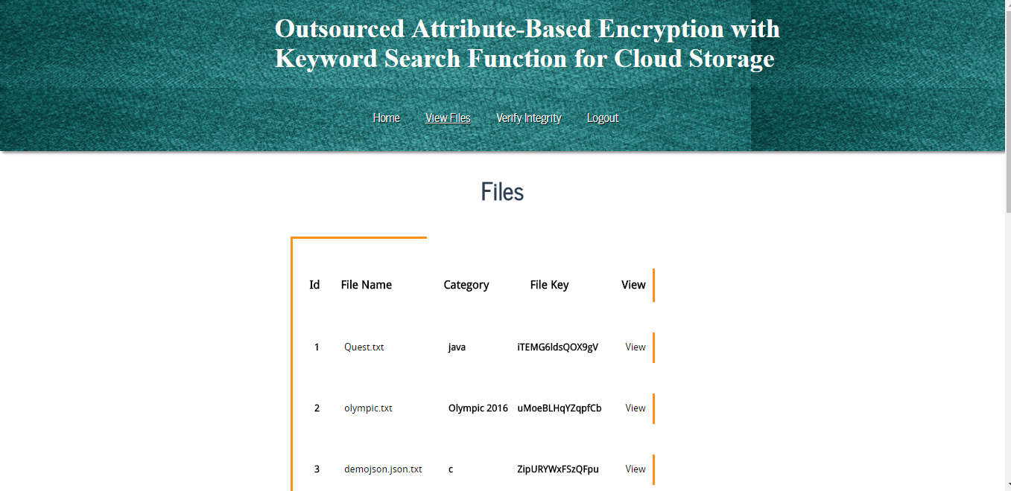
Viewing files that are uploaded

Slide 26
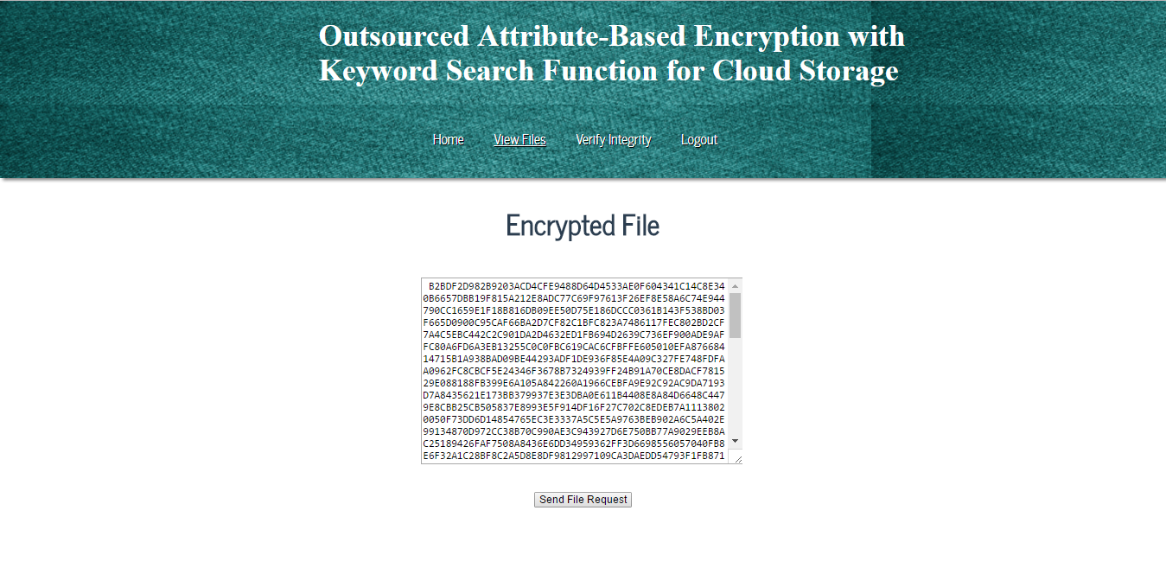
Data in the file is in encrypted format

Slide 27
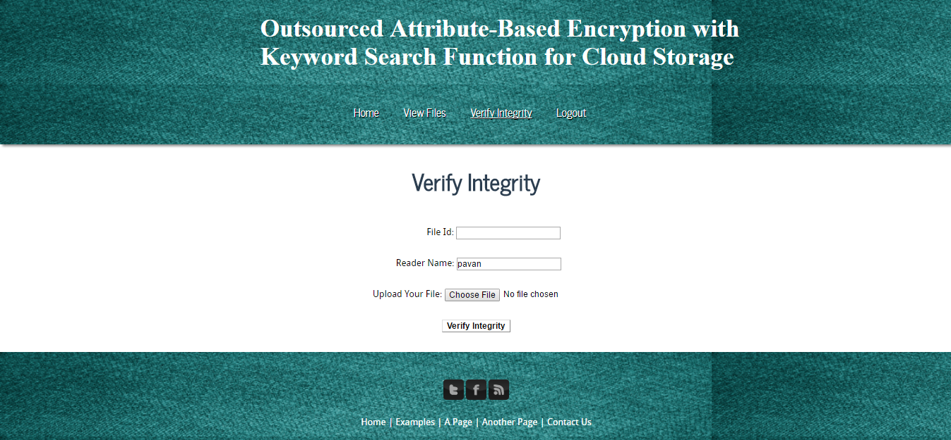
Checking integrity of the file received

Slide 28
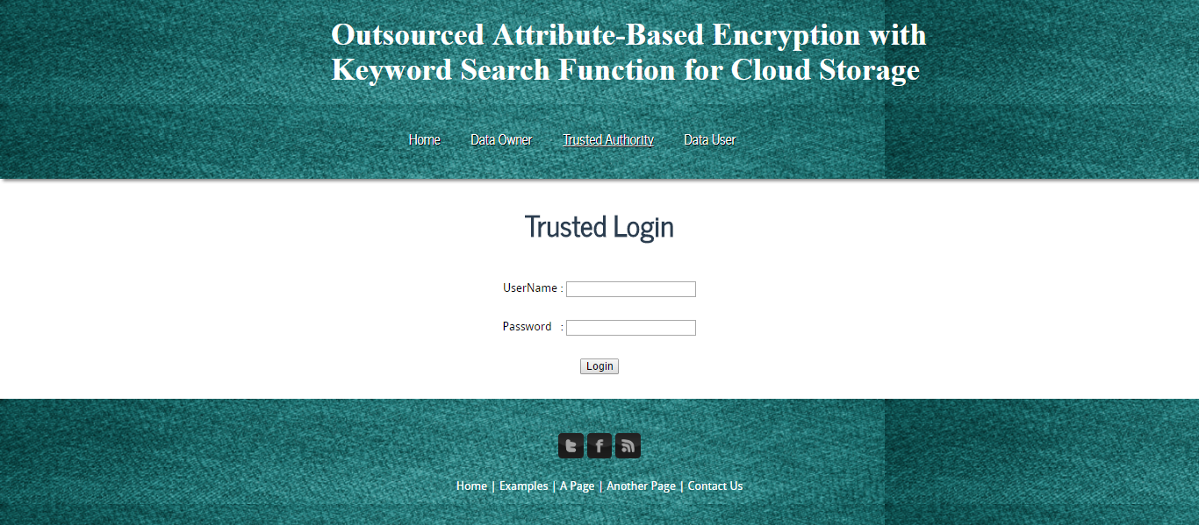
Trusted authority login page

Slide 29
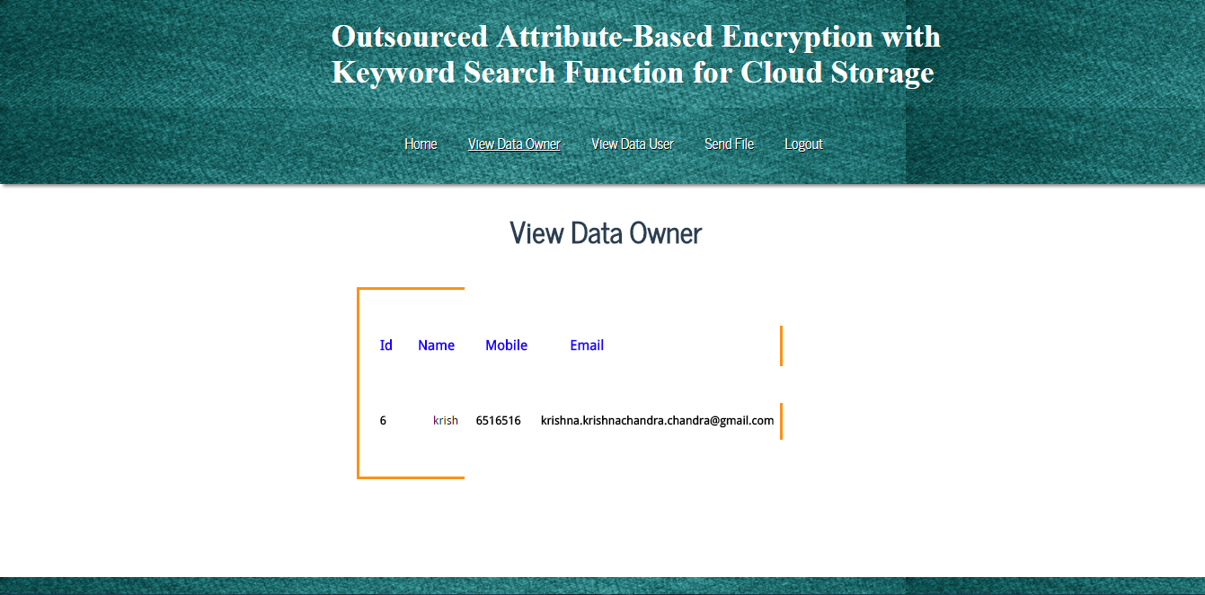
Viewing all the data owners

Slide 30
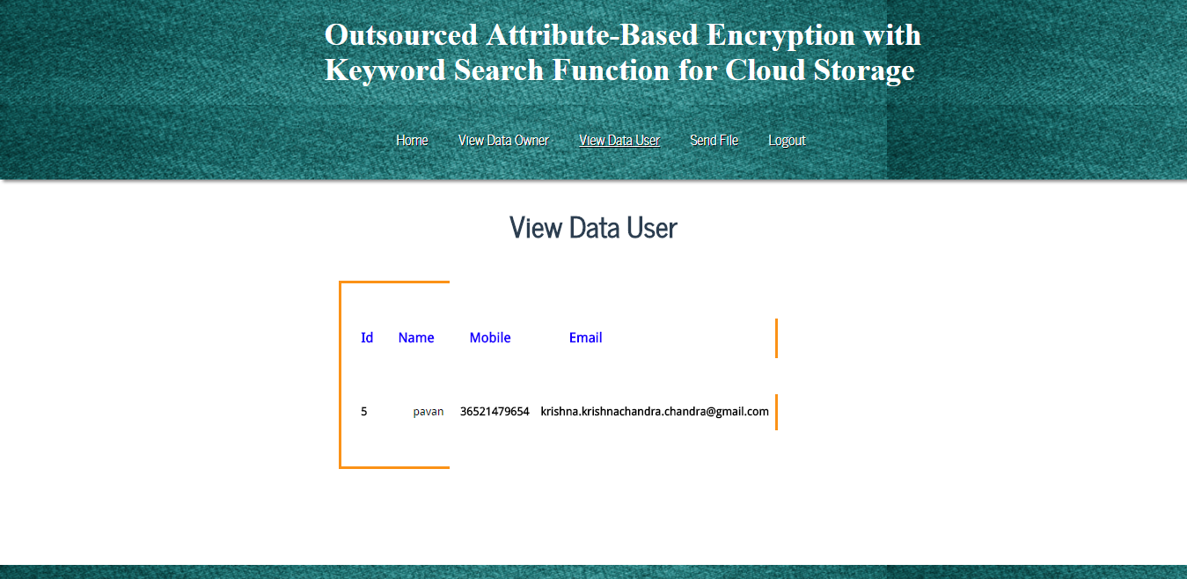
Viewing all the data users

Slide 31
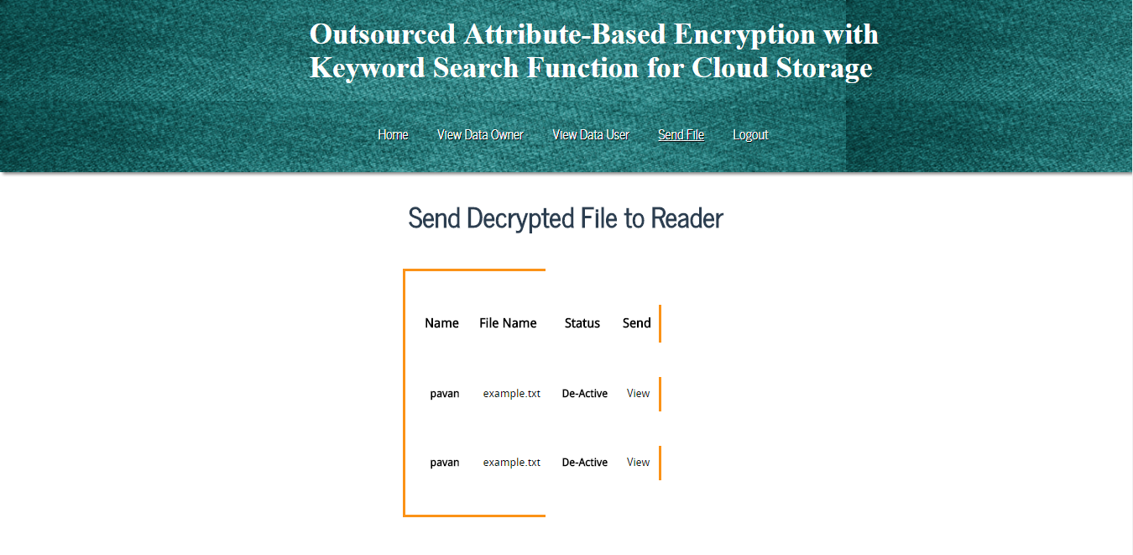
Checking the requests and accepting them

Slide 32
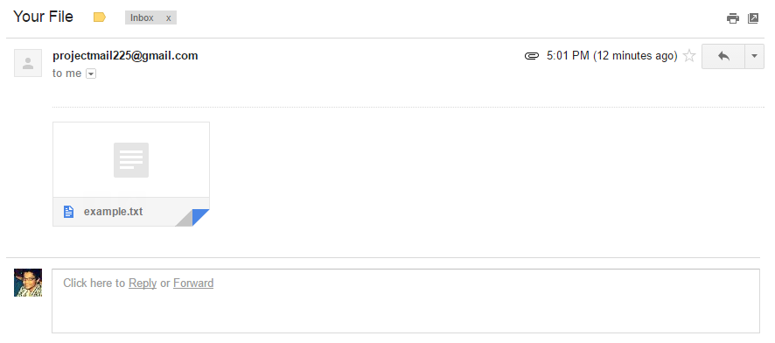
Data user receiving the file in the form of mail

Slide 33
8. CONCLUSIONS
In this article, we propose a CP-ABE scheme that provides outsourcing key-issuing, decryption and keyword search function. Our scheme is efficient since we only need to download the partial decryption ciphertext corresponding to a specific keyword.
In our scheme, the time-consuming pairing operation can be outsourced to the cloud service provider, while the slight operations can be done by users. Thus, the computation cost at both users and trusted authority sides is minimized.
Furthermore, the proposed scheme supports the function of keywords search which can greatly improve communication efficiency and further protect the security and privacy of users.
Actually, we are easy to extend our KSF-OABE scheme to support access structure represented by tree

Slide 34
THANK YOU

